Slide 1
Advanced higher Graphic communication
Computer Aided Illustration

Slide 2
introduction
In this lesson you will learn about the use of rendering technology to create scenes or illustrations with visual impact.
The SQA require you to have a knowledge of the following:
  Texture Mapping
  Bump Mapping
  Lighting (spot, directional, point and ambient)
  Image based lighting
  Volumetrics
  Specularity
  Depth of field

Slide 3
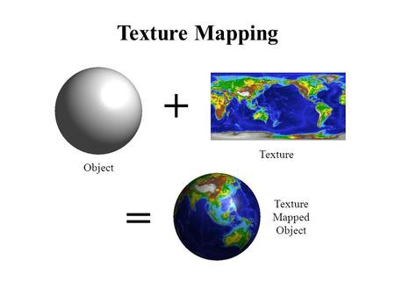
Texture mapping
What is Texture Mapping
In essence, texture mapping is wrapping a 2D image on an 3D object, such that the information of the 2D image is mapped onto the surface of the 3D object, informing the computer to generate the data on the object during rendering. This information can be colour, brightness, smoothness, height, and more. The 2D image is what we know as the texture map.

Slide 4
Bump Mapping
What is Bump Mapping
Bump mapping was invented to create the illusion of bumpiness and depth in objects to increase the realism in them.
Bump maps create the illusion of depth by faking details on the surface using height information to tell when a point should be up or down. The surface however is still flat and not actually warped.

Slide 5
Bump and texture map
When both are applied
Bump Map applied Texture Map Applied Both Applied

Slide 6
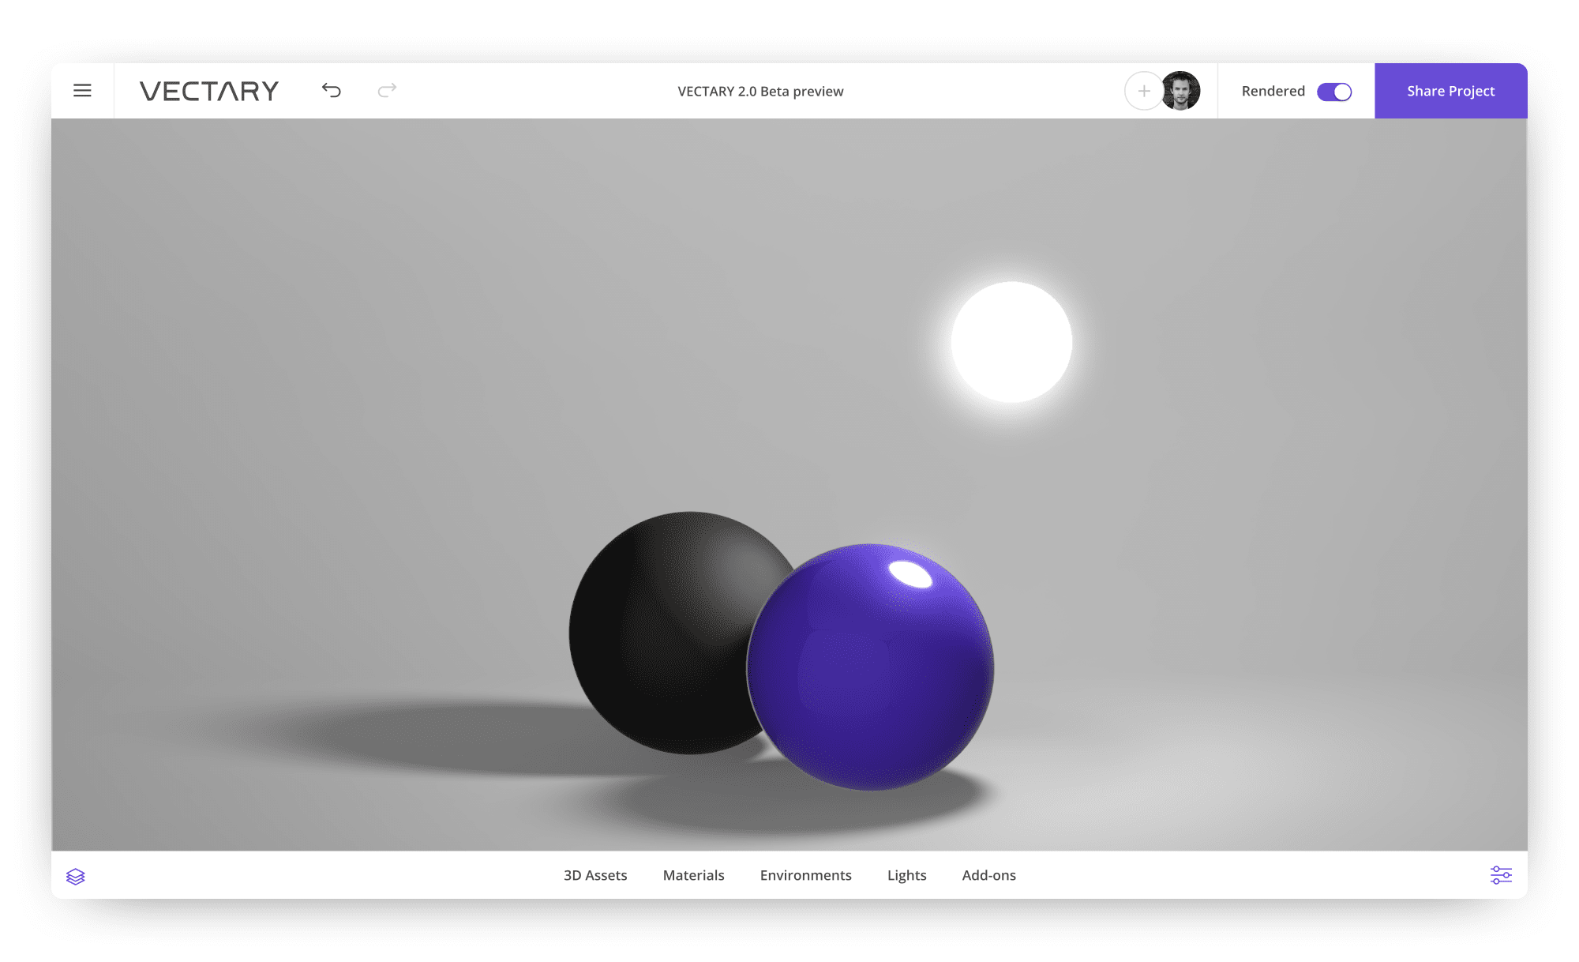
Lighting
Point Lights
A Point Light can be thought of as a point in 3D space from which light is emitted in all directions. Point Light has no specific shape and size. Point lights can add “fill lighting” effect to a 3D scene, as well as simulate any light source like candles, Christmas tree lights, or others.

Slide 7
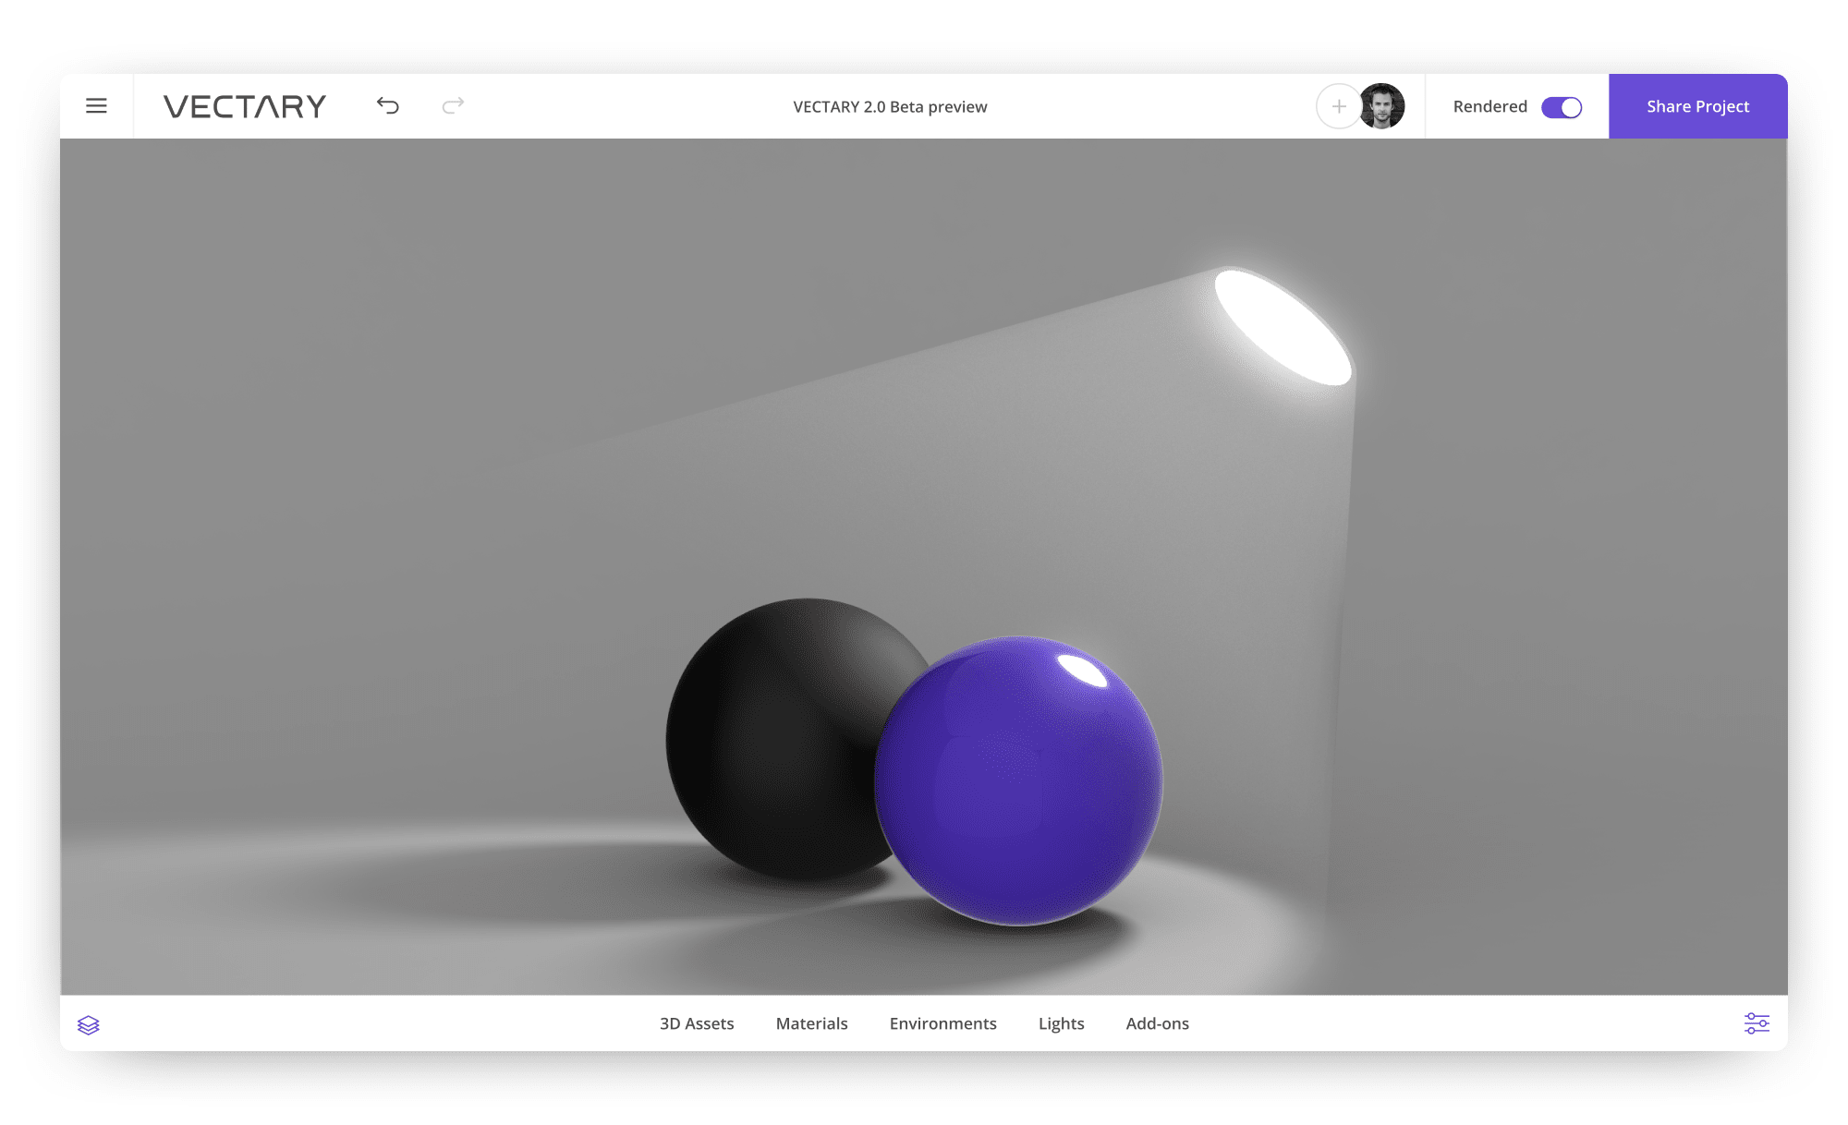
Lighting
Spot Light
Spot light describes exactly what it does – it puts the object in the spotlight by lighting directly onto it from a cone-shaped source of light and creating a circle around the scene with shadows inside. It casts a focused ray of light onto the 3D scene, to make it stand out from other elements in the environment. It resembles a street lamp or an indoor lamp.

Slide 8
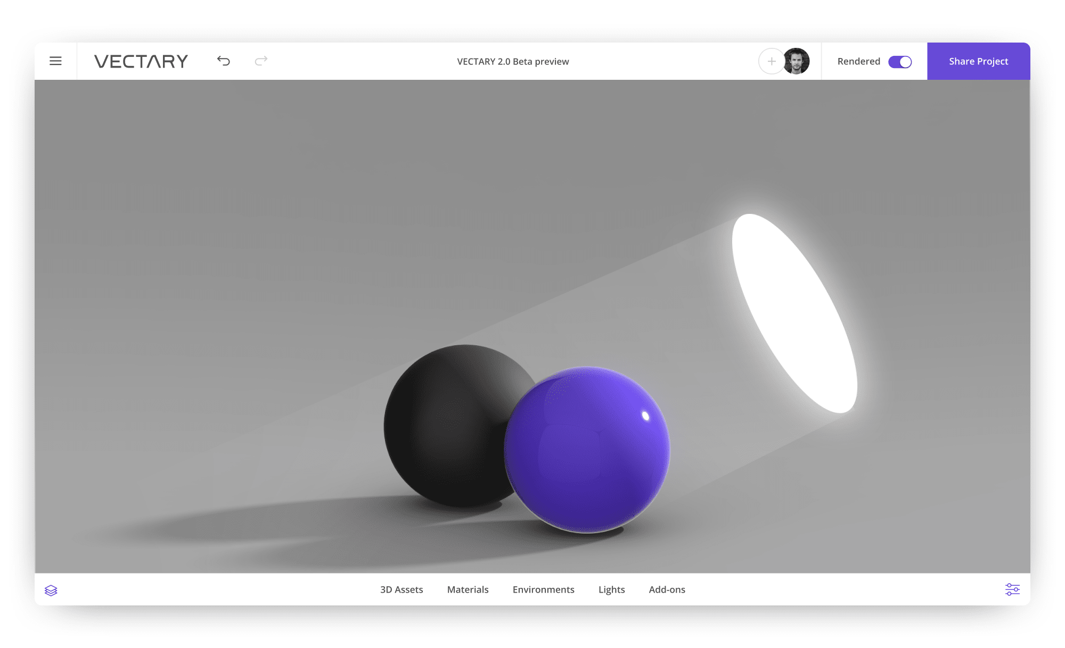
Lighting
Directional Light
Directional light casts rays of parallel light directly onto the object that is placed in the 3D scene. It makes visible the hard shadows caused by the directional impact of the light on the object.

Slide 9
Lighting
Ambient Light
An ambient light is not similar to any other light type. It casts soft rays in every direction, though it has no certain directionality and emits no shadow on the ground. Often it sources as addition to the colour of the main light source for a 3D scene. When sun rays pass through the window of a room they hit the walls and are reflected and scattered into all different directions which averagely brightens up the whole room. This visual quality is described by ambient light.

Slide 10
Lighting
Volumetrics – volume lighting
It is similar to point lighting as it casts rays in all directions from a certain point. Yet, a volume light has a specified shape and size.
Volumetric lighting is a technique used in 3D computer graphics to add lighting effects to a rendered scene. It allows the viewer to see beams of light shining through the environment; seeing sunbeams streaming through an open window is an example of volumetric lighting, also known as God rays

Slide 11
Lighting
Image Based Lighting
Image based lighting simulates how light and shadow from a real environment would interact with a 3D CAD model. Image based lighting often uses a high dynamic range image (HDRI) for greater realism. This image is then projected onto a dome or sphere similar to environment mapping, and this is used to simulate the lighting for the objects in the scene. Almost all modern rendering software offers some type of image based lighting, The spheres below are lit by the kitchen and the forest scene.

Slide 12
Lighting
Specularity
Specularity is the reflective capacity of material to create rings of light reflection. Most 3D rendering packages will offer the option to add, remove and edit the specularity of materials. This will edit the “highlights‟ on the object and can make it appear more or less glossy.

Slide 13
Lighting
Depth-of-Field
The Depth-of-Field effect simulates the natural blurring of foreground and background scene elements when viewed through a camera lens. Depth of Field works by separating the scene in Z order into foreground, background, and in-focus images. The foreground and background images are then blurred according to the values set in the Depth of Field effect parameters and the final image is composited from the processed originals

Slide 14
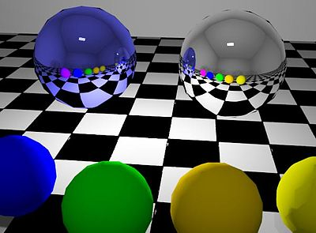
Lighting
Reflections
Reflection in computer graphics is used to emulate reflective objects like mirrors and shiny surfaces. ... Reflection on a shiny surface like wood or tile can add to the photorealistic effects of a 3D rendering.

